Slide 1

San Francisco Crime Classification

Slide 2


Problem Statement
Classifying type of crime in San Francisco city based on Location, Date and Time of the incidents occurred in past.

Slide 3
STEP 4
STEP 3
Model Evaluation
STEP 2
Model Training
STEP 1
Data Pre-processing
Evaluatory Data Analysis
Phases in Project

Slide 4
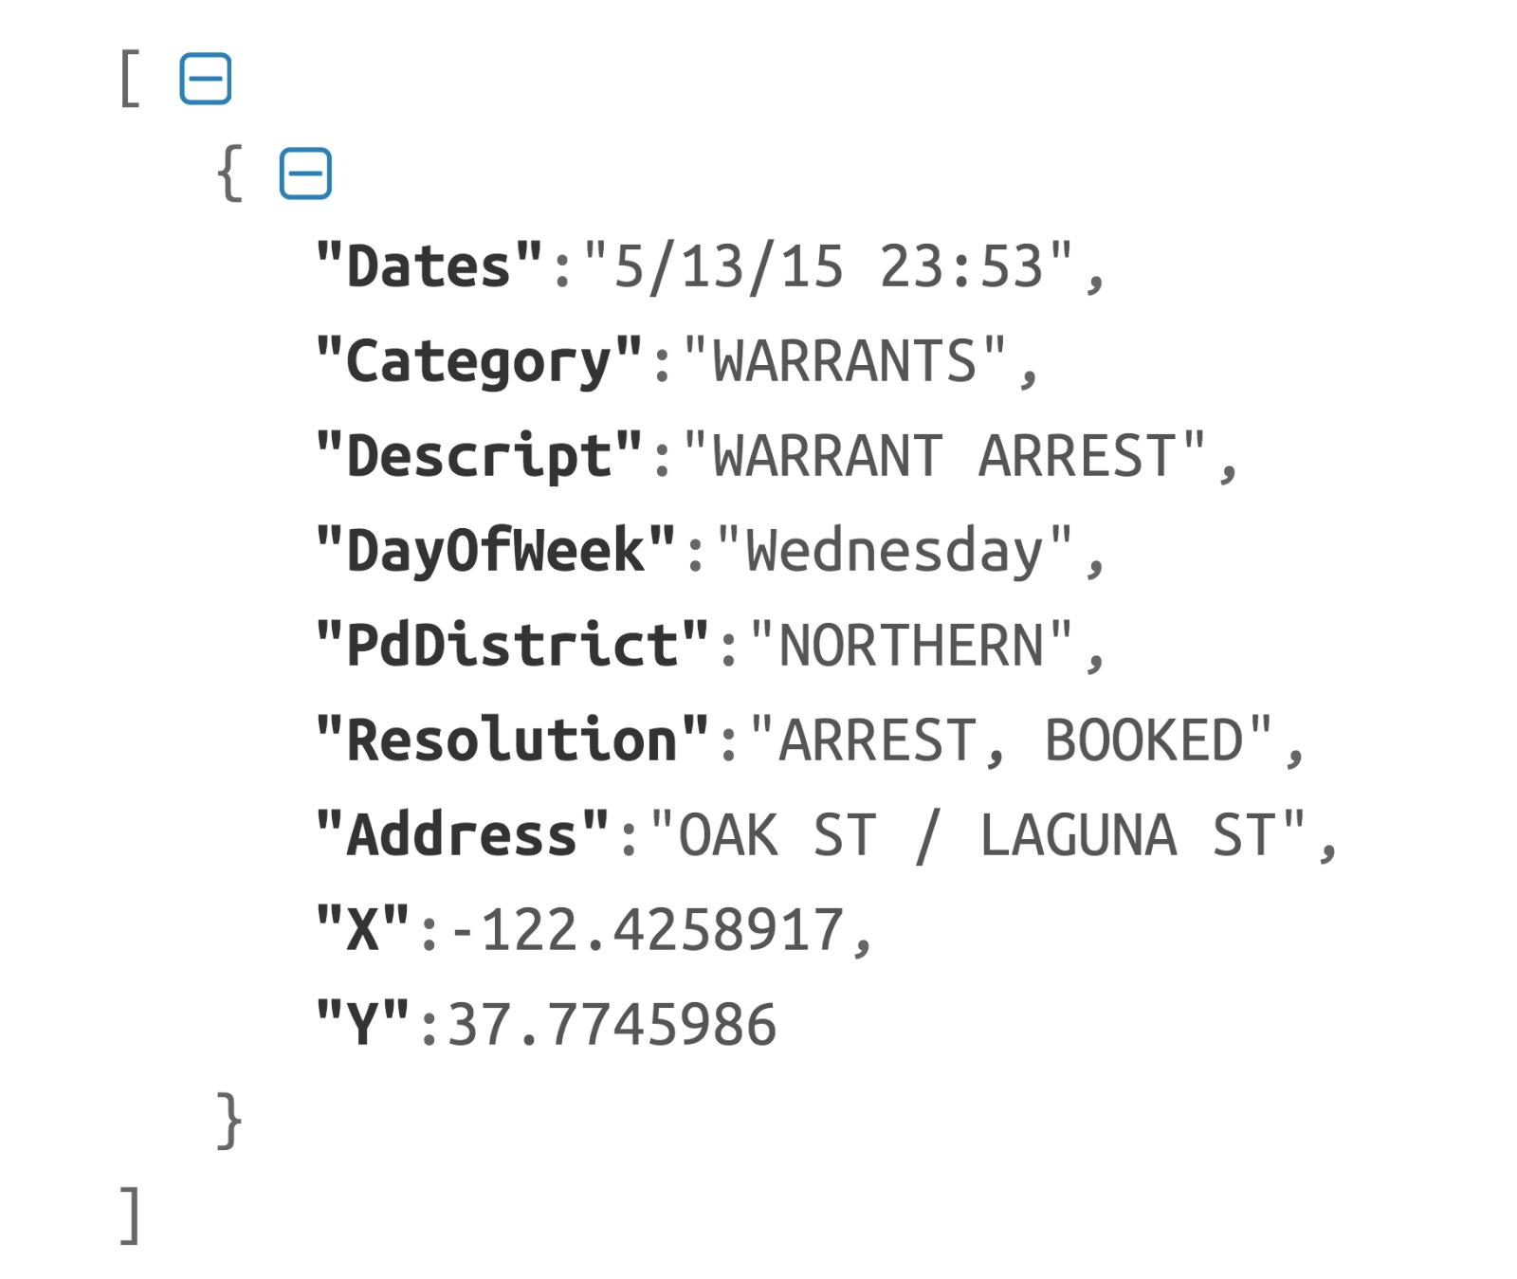
Raw Data (json format)

Slide 5
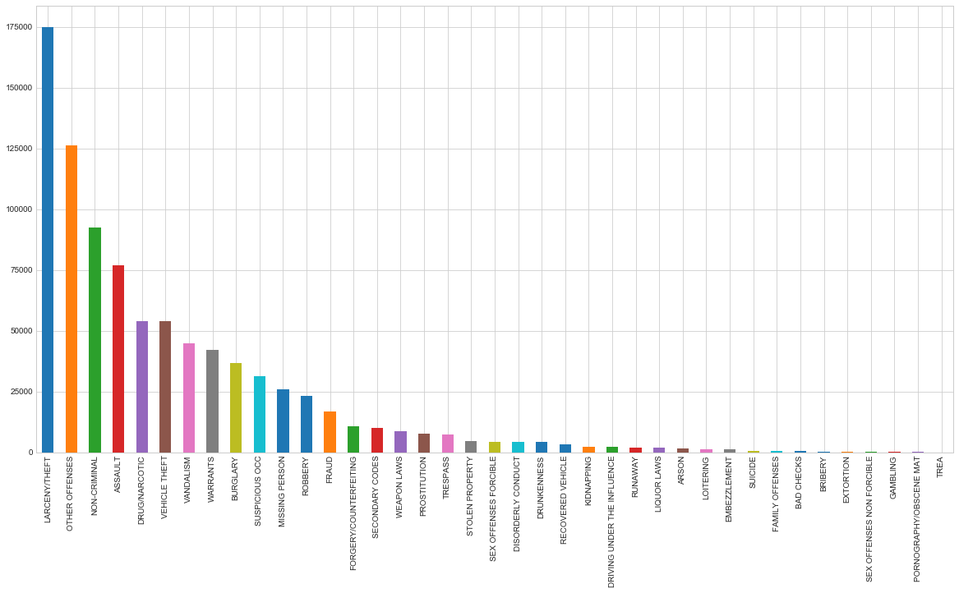
Crime Distribution (39 Categories)

Slide 6
Dates
Year
Day
Month
Minute
Hour
Season
Hour Zone
Date-Time Feature Hierarchy

Slide 7
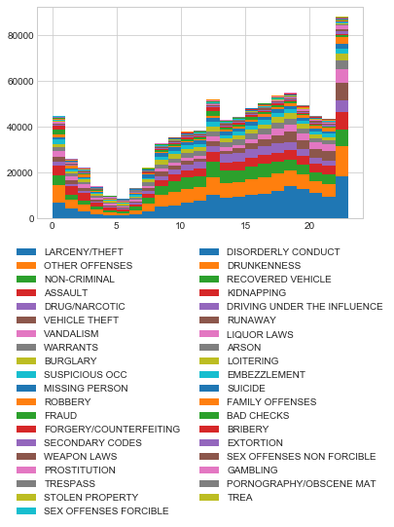
Crime by Hour

Slide 8
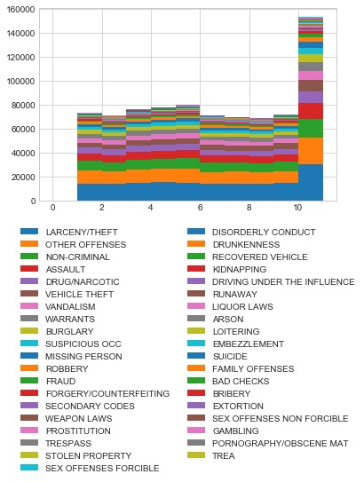
Crime by Month

Slide 9
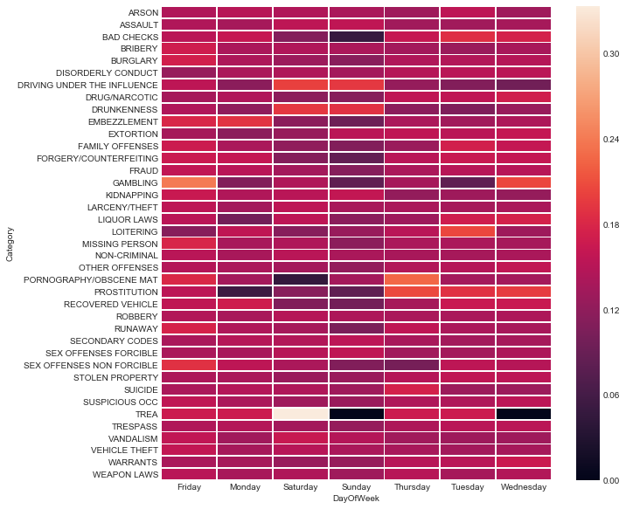
Crime by Day Of Week

Slide 10
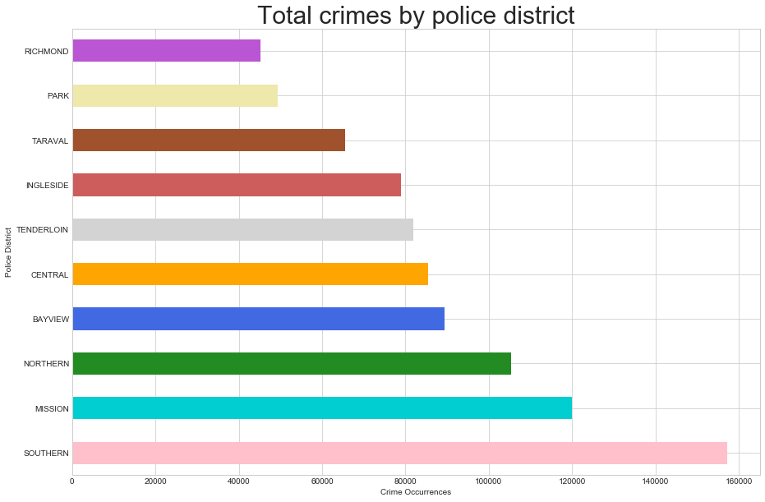

Slide 11
Address
Street 1
Street 2
Is Block
Is Intersection
Location Feature Hierarchy

Slide 12
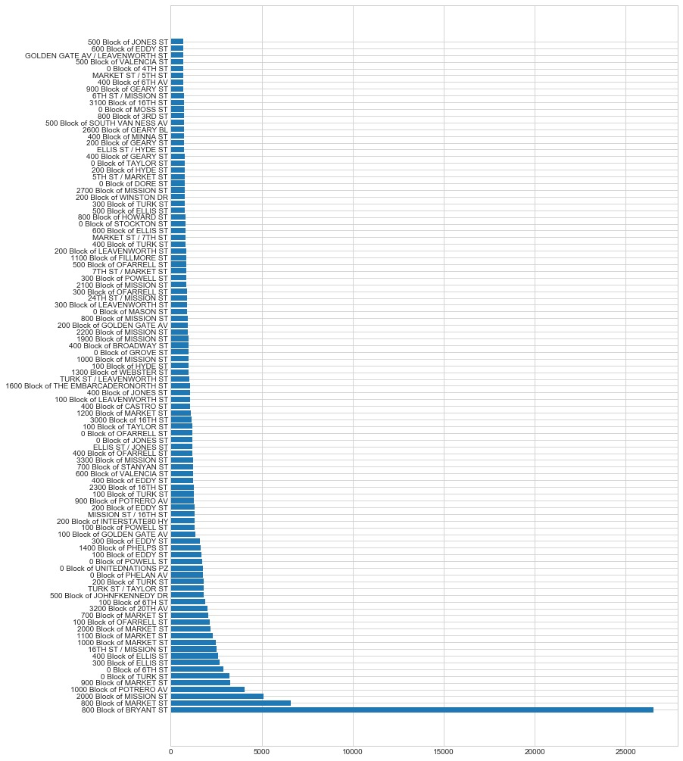
Top streets sorted on crime

Slide 13
Encoding Schemes (Data Pre-processing)
One-hot encoding
Street 1
Street 2
PdDistrict
Year
Day
Hour Zone
Season
Minutes
Label encoding
Category (type of crime)

Slide 14
CLASSIFIERS | Accuracy | F1 score | Precision | Recall
Logistic Regression | 45.13% | 0.4233 | 0.4512 | 0.4122
Nearest Neighbor | 37.62% | 0.3569 | 0.3762 | 0.3585
Support Vector Machine | 43.35% | 0.4031 | 0.4335 | 0.3941
Gaussian Naive Bayes | 41.76% | 0.3920 | 0.4176 | 0.3661
Random Forest | 44.99% | 0.4353 | 0.4499 | 0.4376
Artificial Neural Network | 46.93% | 0.4454 | 0.4693 | 0.4334
Convolutional Neural Network | 45.59% | 0.4248 | 0.4559 | 0.4177
AdaBoost Classifier | 43.58% | 0.4053 | 0.4358 | 0.3975
XGBoost Classifier | 43.58% | 0.4053 | 0.4358 | 0.3975
CLASSIFIERS | Accuracy | Precision | Recall | F1 score
Logistic Regression | 45.13% | 0.4233 | 0.4512 | 0.4122
Nearest Neighbor | 37.62% | 0.3569 | 0.3762 | 0.3585
Support Vector Machine
Gaussian Naive Bayes | 41.76% | 0.3920 | 0.4176 | 0.3661
Random Forest | 44.99% | 0.4353 | 0.4499 | 0.4376
Artificial Neural Network
Convolutional Neural Network
AdaBoost Classifier
XGBoost Classifier
Model Evaluation

Slide 15
CLASSIFIERS | Accuracy | F1 score | Precision | Recall
Logistic Regression | 45.13% | 0.4233 | 0.4512 | 0.4122
Nearest Neighbor | 37.62% | 0.3569 | 0.3762 | 0.3585
Support Vector Machine | 43.35% | 0.4031 | 0.4335 | 0.3941
Gaussian Naive Bayes | 41.76% | 0.3920 | 0.4176 | 0.3661
Random Forest | 44.99% | 0.4353 | 0.4499 | 0.4376
Artificial Neural Network | 46.93% | 0.4454 | 0.4693 | 0.4334
Convolutional Neural Network | 45.59% | 0.4248 | 0.4559 | 0.4177
AdaBoost Classifier | 43.58% | 0.4053 | 0.4358 | 0.3975
XGBoost Classifier | 43.58% | 0.4053 | 0.4358 | 0.3975
Model Evaluation

Slide 16

Chicago Crime Classification
Another Data-set

Slide 17
CLASSIFIERS | Accuracy | Precision | Recall | F1 score
Logistic Regression | 72.43% | 0.6475 | 0.7243 | 0.6737
Nearest Neighbor | 68.76% | 0.6434 | 0.6876 | 0.6609
Support Vector Machine | 71.31% | 0.6173 | 0.7131 | 0.6565
Gaussian Naive Bayes | 59.86% | 0.6472 | 0.5986 | 0.6008
Random Forest | 71.33% | 0.6574 | 0.7133 | 0.6737
Artificial Neural Network | 72.88% | 0.6769 | 0.7288 | 0.6792
Convolutional Neural Network | 72.42% | 0.6537 | 0.7242 | 0.6738
AdaBoost Classifier | 70.92% | 0.6289 | 0.7092 | 0.6536
XGBoost Classifier | 70.92% | 0.6289 | 0.7092 | 0.6536
Model Evaluation

Slide 18
Any Questions

Slide 19
Thank you

